Slide 1



A tail of two extremes
Energetics and the evolution
of extream body size

Slide 2
What I do
Scaling in Species interactions

Slide 3
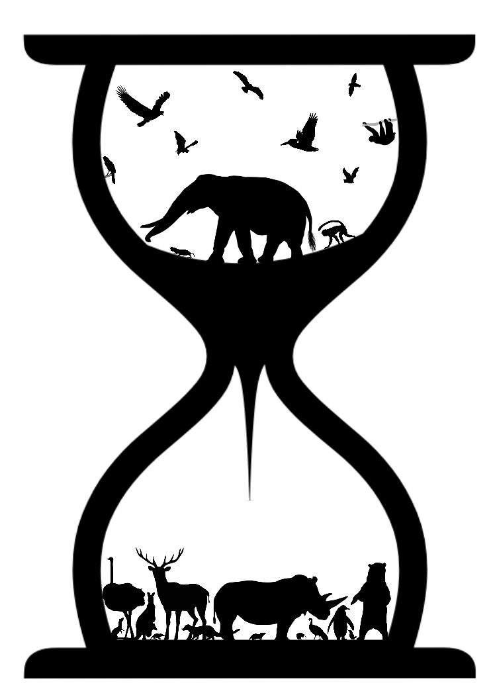

Slide 4


Slide 5
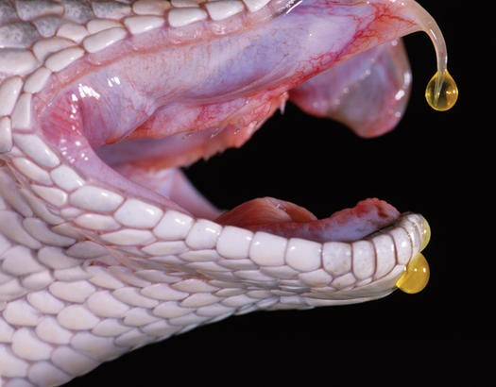

Slide 6
The evolution of foraging
Constrain possible evolutionary trajectories

Slide 7
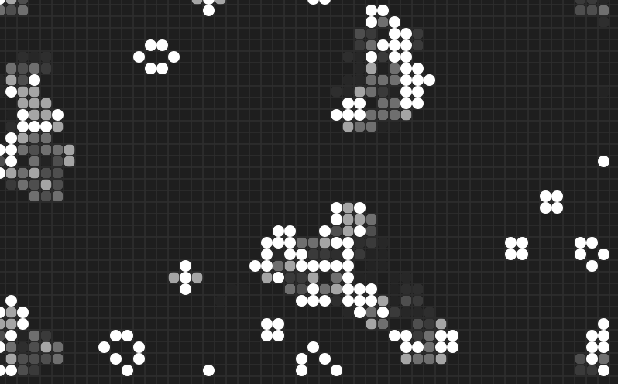

Slide 8
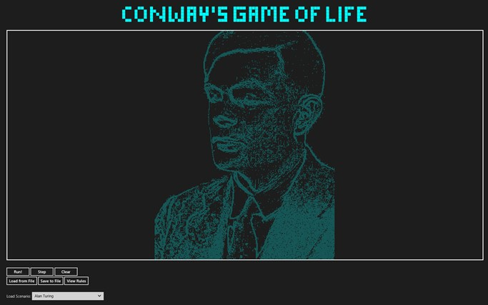

Slide 9
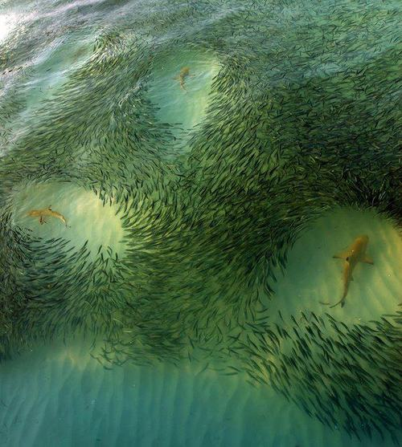

Slide 10


Slide 11
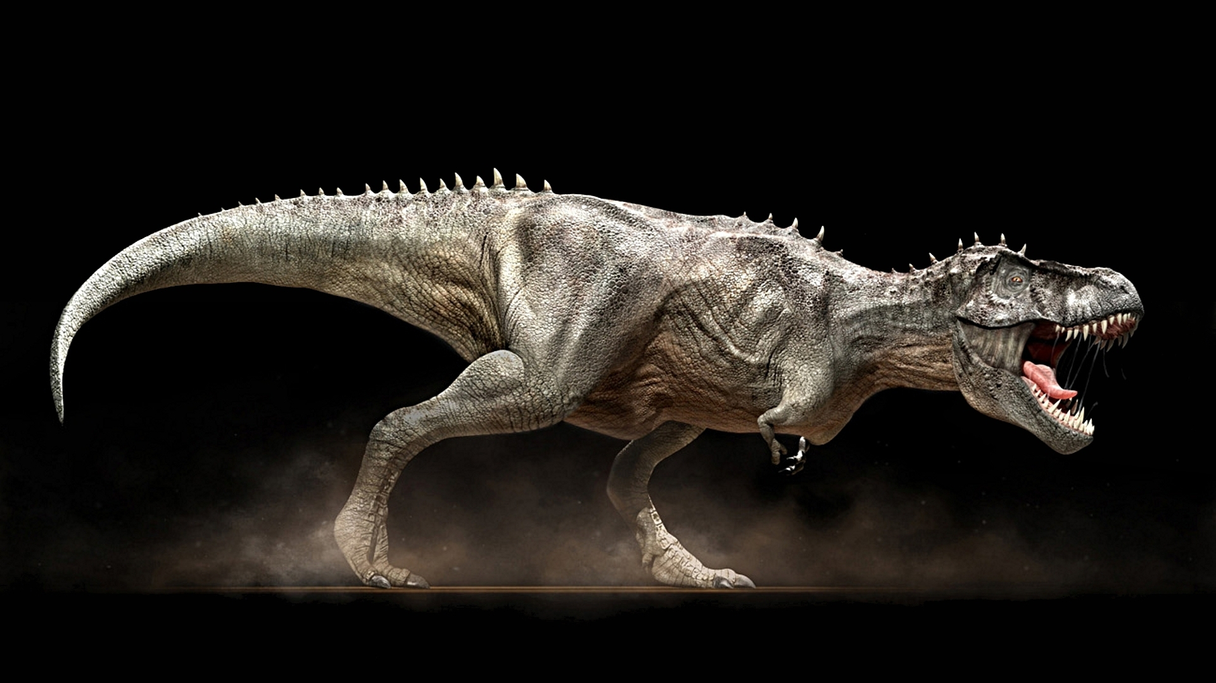
Theropods and scavaging
Extrinsic mortality and longevity in flying, digging and climbing endotherms

Slide 12





Slide 13
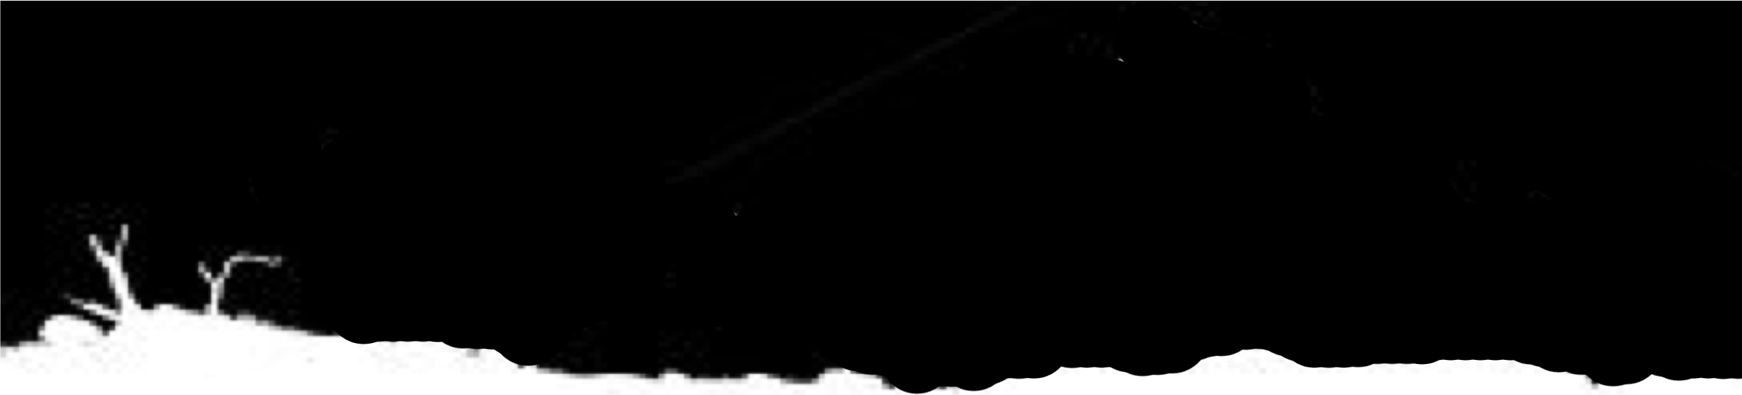

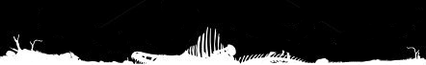
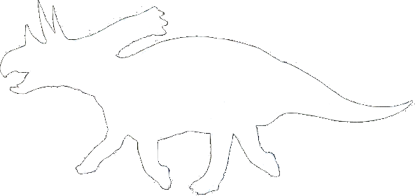
Predator
Scavanger

Slide 14
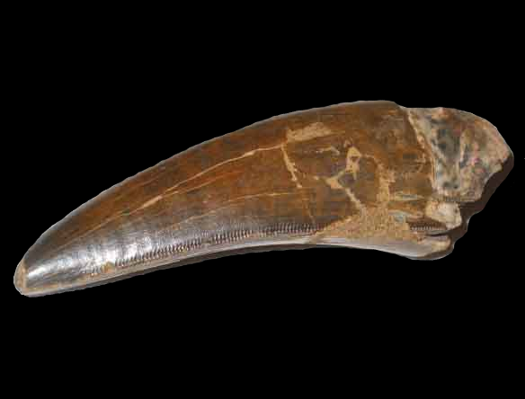
Predator
Scavanger

Slide 15
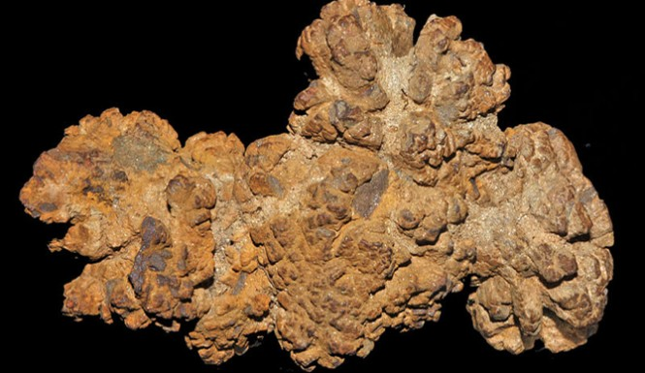
Predator
Scavanger

Slide 16
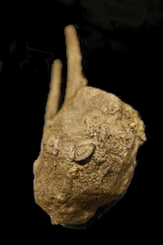
Predator
Scavanger

Slide 17
6
Energy
(KiloJoules)
0
Mass (tons)
10
0

Slide 18
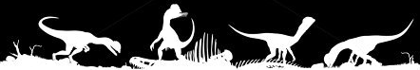
6
Energy
(KiloJoules)
0
Mass (tons)
10
0

Slide 19


Obligate
6
Energy
(KiloJoules)
0
Mass (tons)
10
0

Slide 20


6
Energy
(KiloJoules)
0
Mass (tons)
10
0

Slide 21
Facultative
6
Energy
(KiloJoules)
0
Mass (tons)
10
0

Slide 22
6
0
Energy
(KiloJoules)
Mass (tons)
0
1
5
10

Slide 23
6
0
Energy
(KiloJoules)
Mass (tons)
1
5
10
0

Slide 24
6
0
Energy
(KiloJoules)
Mass (tons)
1
5
10
0

Slide 25
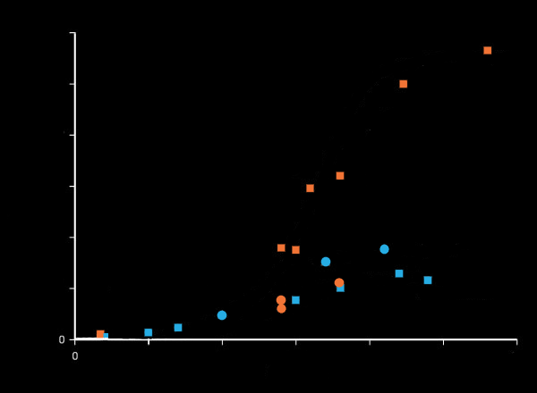
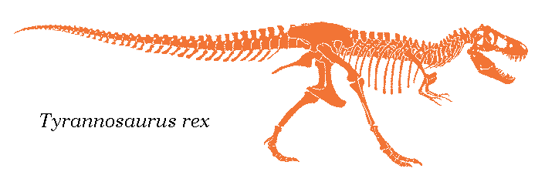
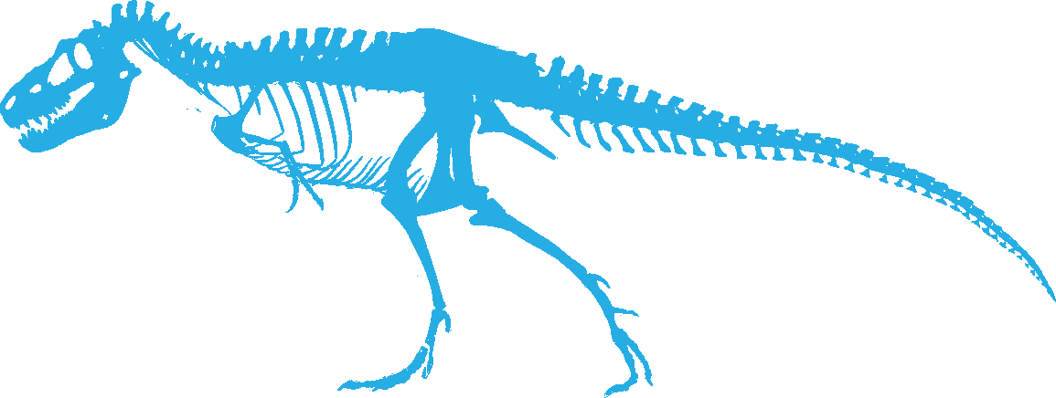
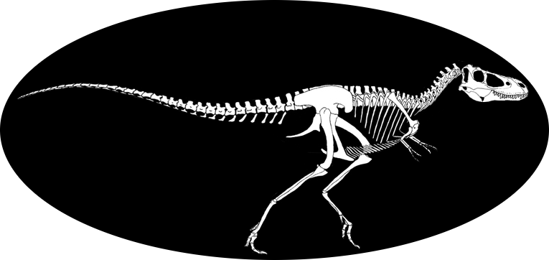
6
Mass
(tons)
0
Age (yrs)
30
0

Slide 26

6
0
Energy
(KJ/Day)
-3x10^8
Mass (tons)
5
10
0

Slide 27
6
0
Energy
(KJ/Day)
-3x10^8
Mass (tons)
5
10
0

Slide 28
6
0
Energy
(KJ/Day)
-3x10^8
Mass (tons)
5
10
0

